Slide 1
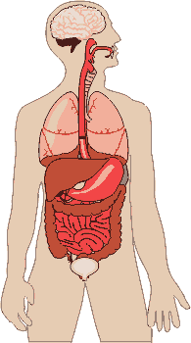
HUMAN BODY

Slide 2








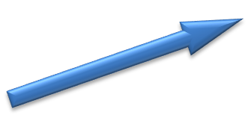

S0ME OF THE MAJOR ORGANS IN THE HUMAN BODY
THE BRAIN
THE LUNGS
THE LIVER
THE STOMACH
THE BLADDER
NEXT

Slide 3
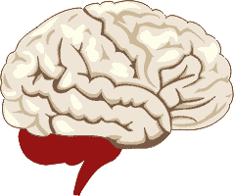
BRAIN

Slide 4

LUNGS

Slide 5
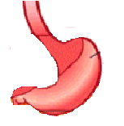
STOMACH

Slide 6
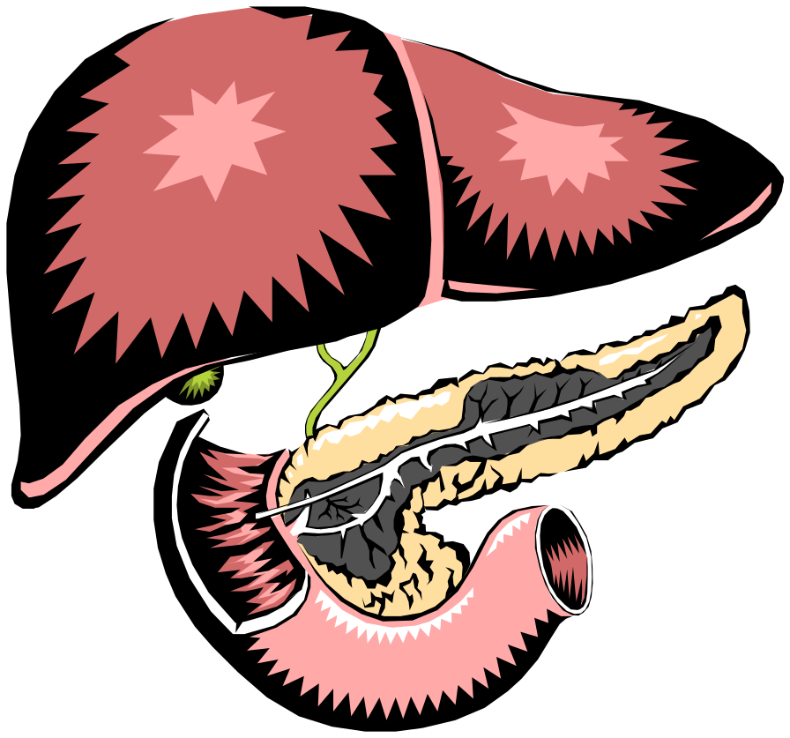
LIVER

Slide 7

BLADDER

Slide 8
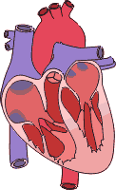
HEART

Slide 9
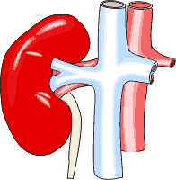
KIDNEYS

Slide 10
S0ME OF THE MAJOR ORGANS IN THE HUMAN BODY
THE BRAIN
THE LUNGS
THE LIVER
THE STOMACH
THE BLADDER

Slide 11
BRAIN
Brain is the most important organ in your body.
The Brain controls your body and everything it does.
Without your brain you would not be able to breathe, walk, talk, learn, think, remember things, as well as be able to feel happy or sad.
Your brain sends signals through your body through your nerves. Your nerves allow you to feel and touch objects.
Different parts of our brain control different parts of our body, we need all of these parts of our brain to work properly.

Slide 12
LUNGS
Lungs are the organs which help us to breathe.
We breathe in air (oxygen) through our nose and mouth.
The oxygen is then taken into our body travelling through the blood stream to body cells, the body cells then use the oxygen to get energy.
Waste substances like carbon dioxide (a waste gas) are then released into the blood carried to the lungs to leave the blood and is then breathed out through our mouth and nose.

Slide 13
STOMACH
Stomach is where our food goes.
Our stomach holds the food we have eaten, which it then begins to break down through the contracting of the muscles in the stomach walls.
After two hours of the stomach digesting the food we have eaten it then leaves the stomach and travels to another part of our body known as the small intestine.
Without a stomach we would have no place in our body to store food.
This would then prevent us from eating therefore not allowing for us to survive.

Slide 14
LIVER
Liver has many jobs but its main job is to filter out all the poisonous substances in your blood.
Without the liver acting as a filter in our body it would be full of poisonous substances polluting our body, without this we would not be alive.
The liver also produces a liquid called bile which breaks down all the fats in our body which aids digestion.

Slide 15
BLADDER
Bladder is where urine is stored.
The urine travels from the Kidneys to the bladder, it is in the bladder where our urine is stored, which will later pass out of our body when we go to the toilet.
Without our bladder we would become polluted by our own waste due to the reason that there is no where else for it to travel or another way in which it can be passed out.

Slide 16
HEART
The Heart the other most important organ within your body.
The Heart’s job is to keep us alive through pumping blood around our body. Our heart sends our blood on a never ending journey through our bodies.
The two chambers in our hearts are pumps which pump the blood to different places in our body which allows the rest of the organs in our body to work.
One takes blood to the rest of our body the other takes it to the lungs. Without the heart pumping blood through these organs in our veins the rest of our body would not work. When our heart stops pumping the blood around our body this is when we die.

Slide 17
Kidneys
Kidney’s are small bean shaped organ’s which lie either side of your body.
The blood which travels through the kidneys deposits the waste the blood has gathered on its journey through your body.
Small filters, filter out the impurities from the blood, the impurities travel to the middle of your kidney which develops a liquid called urine.
The kidneys help us to get rid of waste in our bodies through producing the urine which travels on to our bladders.

Slide 18


Body
Our body lives and works through all the hard work are organs do to keep us alive.
Whether we are walking, talking, sleeping, playing or sitting, our body is constantly working hard to keeps us in full health keeping us fit.
As long as we continue to treat our body with care it will take care of us. Through eating healthily and keeping an active lifestyle our body will continue to work to its full potential allowing us to enjoy a long life.

Slide 19
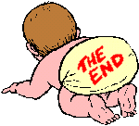
Thanks
Submitted by
Abhishek
Noida

